Slide 1

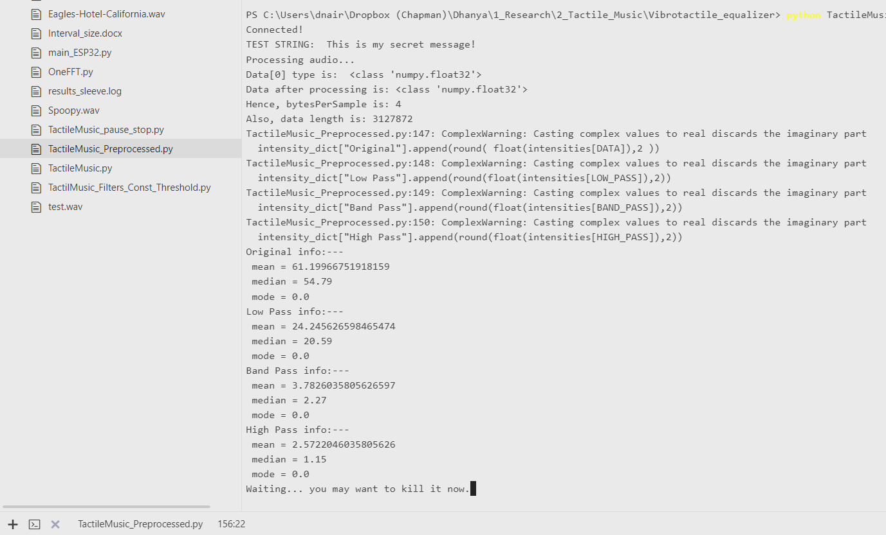
Stats for the entire:
These are the values used.
Independent of interval.
Stats based on the average of each segment:
Notes:
Hotel California – 0.2s interval

Slide 2
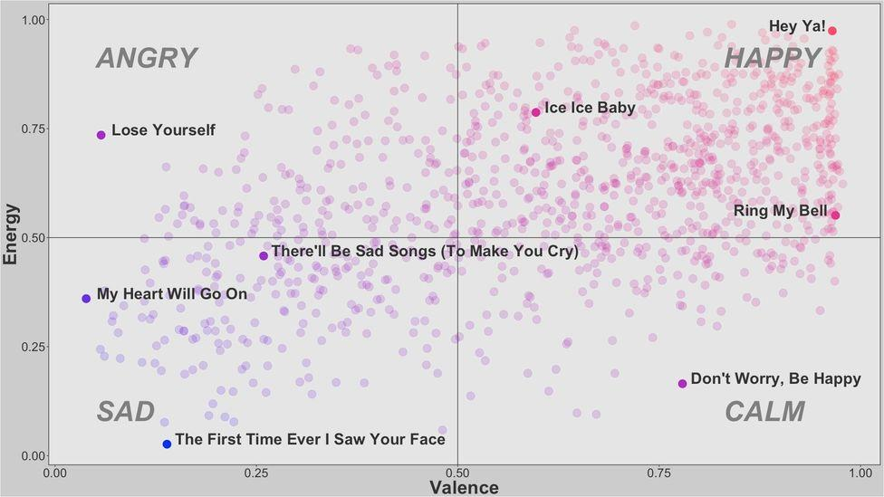
Spotify’s algo based song classification
Link to the classifier, based on Spotify API:
https://www.bbc.com/culture/article/20180821-can-data-reveal-the-saddest-song-ever?ocid=twcul&referer=https%3A%2F%2Ft.co%2F
Large repository of happy –sad songs, as classified by Spotify: (Also has steps on how to get started.)
https://rinzewind.org/blog-en/2016/what-are-the-saddest-and-happiest-songs-a-spotify-data-analysis-project.html

Slide 3
Download songs
Download songs: https://mp3quack.lol/
Convert MP3 to WAV: https://convertio.co/download/734e1bec3a550f3a634cc76a49a82fb64de6d1/

Slide 4
Testing
Training:
Hear & feel 2 songs on the different end of the spectrum.
Testing:
Play the vibrations of the 2 songs, 5 times each (randomly) and ask the user to identify the song.
If possible, play 1 more of the same genre and ask them to classify it.

Slide 5
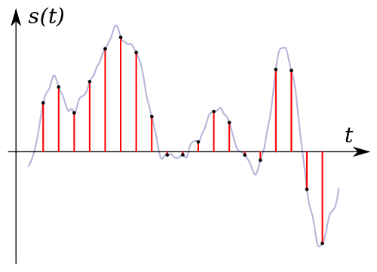
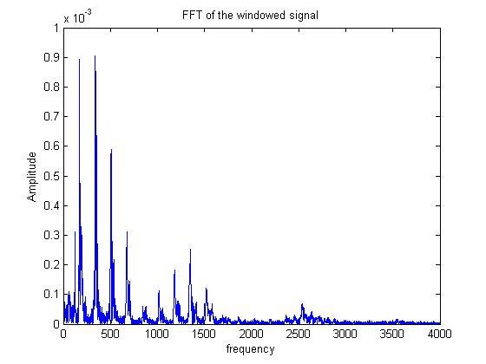
Notes:
Random images that might help explain the algorithm better.

